Slide 1
ECEG-5193: Algorithm Analysis and Design
Problem Complexity and Type
Problem Complexity and Type

Slide 2
Defining Efficiency
Classical definition of efficiency:
An algorithm is efficient iff it runs in polynomial time on a serial computer.
Runtimes of “efficient” algorithms:
O(n) O(n log n) O(n³ log² n) _{O(n}10,000,000,000₎
Runtimes of “inefficient” algorithms:
O(2^{n}) O(n!) O(1.00000001^{n})

Slide 3
NP-Completeness
So far we’ve seen a lot of good news!
Such-and-such a problem can be solved quickly (i.e., in close to linear time, or at least a time that is some small polynomial function of the input size)
NP-completeness is a form of bad news!
Evidence that many important problems can not be solved quickly.
NP-complete problems really come up all the time!

Slide 4
Some Caveats
Parallelism: Some problems can be solved in time O(log^{k} n) time on machines with a polynomial number of processors.
Are all efficient algorithms parallelizable?
Randomization: Some algorithms can be solved in expected polynomial time, or have poly-time Monte Carlo algorithms that work with high probability.
Are randomized efficient algorithms efficient solutions?
Quantum computation: Some algorithms can be solved in polynomial time on a quantum computer.
Are quantum efficient algorithms efficient solutions?
These are all open problems!

Slide 5
Why should we care?
Knowing that they are hard lets you stop beating your head against a wall trying to solve them…
Use a heuristic: come up with a method for solving a reasonable fraction of the common cases.
Solve approximately: come up with a solution that you can prove that is close to right.
Use an exponential time solution: if you really have to solve the problem exactly and stop worrying about finding a better solution.

Slide 6
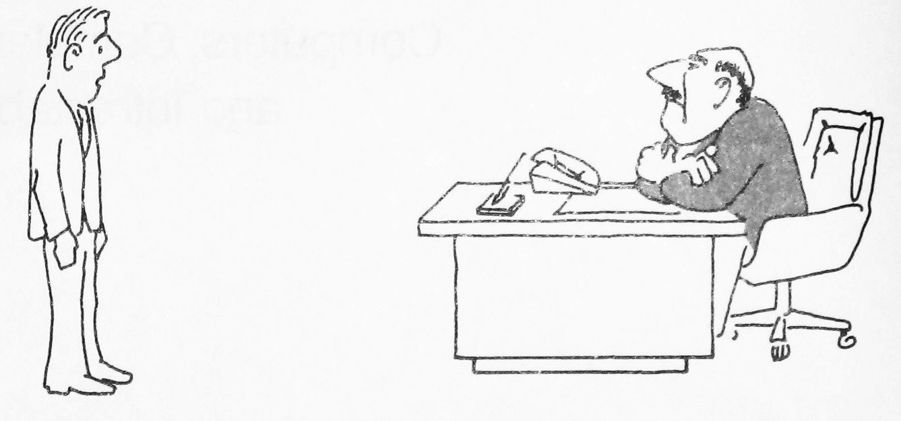
What you’d rather not say…
“I can’t find an efficient algorithm, I guess I’m just too dumb.”

Slide 7
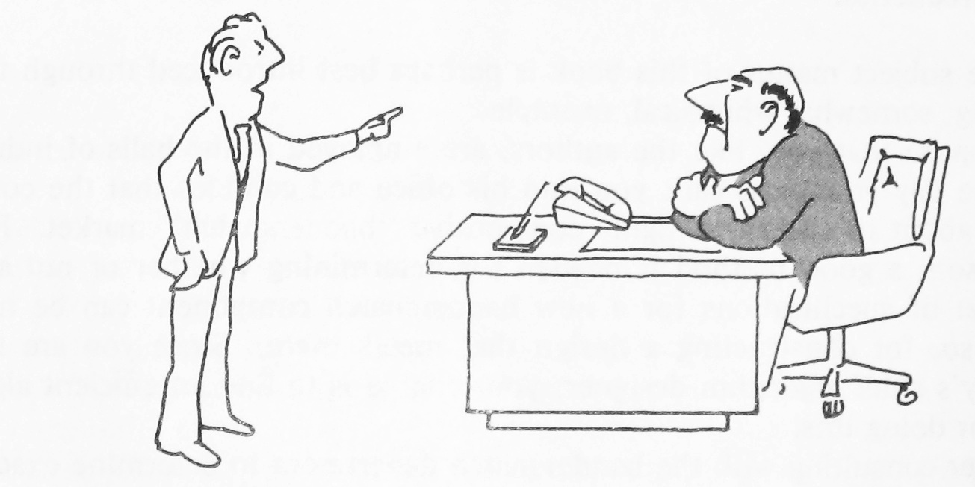
What you’d like to say…
“I can’t find an efficient algorithm, because no such algorithm is possible!”
But can you actually say this…?

Slide 8
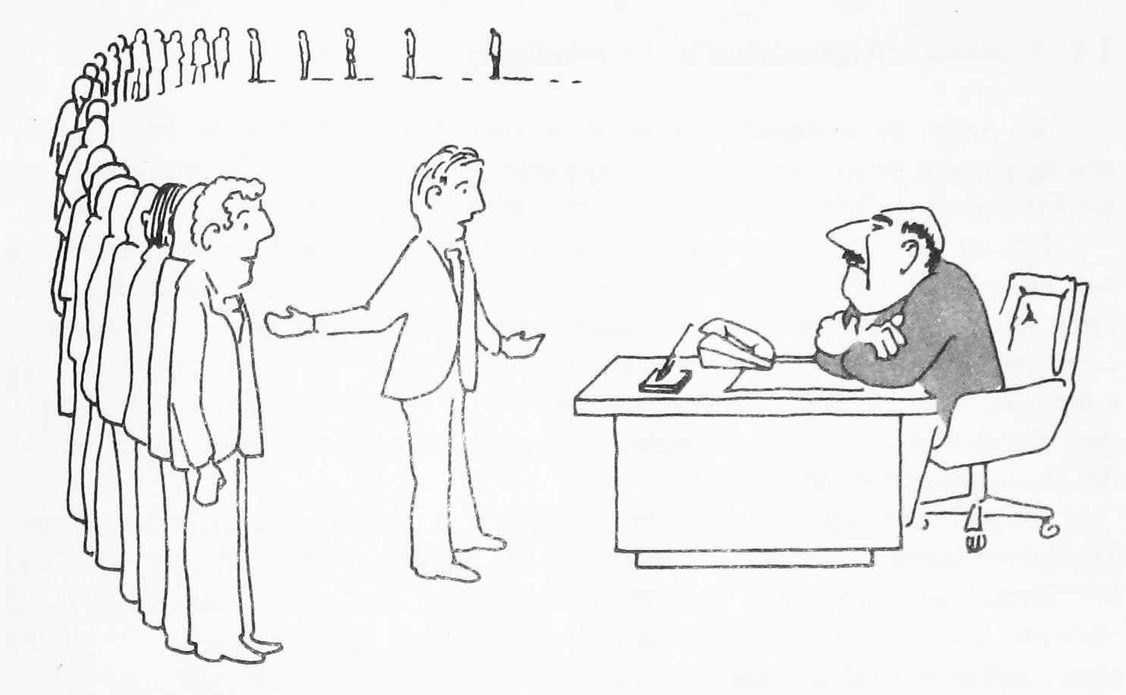
What you can say…
“I can’t find an efficient algorithm, but neither can all these famous people.”

Slide 9
Class of “P” Problems

Slide 10
Class of “P” Problems
Class P consists of (decision) problems that are solvable in polynomial time
Polynomial-time algorithms
Worst-case running time is O(n^{k}), for some constant k
Examples of polynomial time:
O(n²), O(n³), O(1), O(n lg n)
Examples of non-polynomial time:
O(2^{n}), O(n^{n}), O(n!)

Slide 11
Tractable vs Intractable Problems

Slide 12
Tractable/Intractable Problems
Problems in P are also called tractable
Problems not in P are intractable or unsolvable
Can be solved in reasonable time only for small inputs
Or, can not be solved at all
Are non-polynomial algorithms always worst than polynomial algorithms?
- n^{1,000,000} is technically tractable, but really impossible
- n^{log log log n} is technically intractable, but easy

Slide 13
Example of Unsolvable Problem
Turing discovered in the 1930’s that there are problems unsolvable by any algorithm.
The most famous of them is the halting problem
Given an arbitrary algorithm and its input, will that algorithm eventually halt, or will it continue forever in an “infinite loop?”

Slide 14
Optimization & Decision Problems

Slide 15
Optimization & Decision Problems
Decision problems
Given an input and a question regarding a problem, determine if the answer is yes or no
Optimization problems
Find a solution with the “best” value
Optimization problems can be cast as decision problems that are easier to study
Shortest path: G = unweighted directed graph
Find a path between u and v that uses the fewest edges
Does a path exist from u to v consisting of at most k edges?

Slide 16
Optimization & Decision Problems
Hamiltonian Path
Optimization Problem: Given a graph, find a path that passes thorough every vertex exactly once.
Decision problem: Does a given graph have a Hamiltonian Path?
Traveling Salesman
Optimization Problem: Find the minimum weight Hamiltonian Path.
Decision problem: Given a graph and an integer k, is there a Hamiltonian path with a total weight at most k??

Slide 17
Determinism vs. Nondeterminism
Nondeterministic algorithms produce an answer by a series of “correct guesses”
Deterministic algorithms (like those that a computer executes) make decisions based on information.

Slide 18
Nondeterministic and NP Algorithms
Nondeterministic Algorithm = two stage procedure:
1. Nondeterministic (“guessing”) stage:
Generate randomly an arbitrary string that can be thought of as a candidate solution (“certificate”)
2. Deterministic (“verification”) stage:
Take the certificate and the instance to the problem and returns YES if the certificate represents a solution
NP algorithms (Nondeterministic Polynomial)
Verification stage is polynomial

Slide 19
Certificates
Returning true: In order to show that the schedule can be made, we only have to show one schedule that works
This is called a certificate.
Returning false: In order to show that the schedule cannot be made, we must test all schedules.

Slide 20
Certificate: Hamiltonian Cycle
Given: a directed graph G = (V, E), determine a simple cycle that contains each vertex in V
Each vertex can only be visited once
Certificate:
Sequence: ⟨v₁, v₂, v₃, …, v_{|V|}⟩
Hamiltonian
not
Hamiltonian

Slide 21
Oracles
If we could make the ‘right decision’ at all decision points, then we can determine whether a solution is possible very quickly!
If the found solution is valid, then True
If the found solution is invalid, then False
If we could find the certificates quickly, NP-complete problems would become tractable – O(N)
This (magic) process that can always make the right guess is called an Oracle.

Slide 22
Intractable Problems
Can be classified in various categories based on their degree of difficulty, e.g.,
NP
NP-complete
NP-hard
Let’s define NP algorithms and NP problems …
Warning: NP does not mean “non-polynomial”

Slide 23
NP-Complete
“NP-Complete” comes from:
Nondeterministic Polynomial
Complete - “Solve one, Solve them all”
There are more NP-Complete problems than provably intractable problems.

Slide 24
Is P = NP?
P
NP
Any problem in P is also in NP:
P ⊆ NP
The big (and open question) is whether NP ⊆ P or P = NP
i.e., if it is always easy to check a solution, should it also be easy to find a solution?
Most computer scientists believe that this is false but we do not have a proof …

Slide 25
NP-Completeness (informally)
P
NP-complete problems are
defined as the hardest
problems in NP
Most practical problems turn out to be either P or NP-complete.
NP
NP-Complete
Study NP-complete problems …
This is an open problem: the P ≟ NP question has a $1,000,000 bounty!

Slide 26
NP-Completeness (formally)
P
A problem B is NP-complete if:
(1) B ∈ NP
(2) A ≤_{p} B for all A ∈ NP
If B satisfies only property (2) we say that B is NP-hard
No polynomial time algorithm has been discovered for an NP-Complete problem.
NP
NP-Complete
No one has ever proven that no polynomial time algorithm can exist for any NP-Complete problem

Slide 27
Revisit “Is P = NP?”
P
NP
NP-Complete
Theorem:
If any NP-Complete problem can be solved in polynomial time ⇒ then P = NP.

Slide 28
Become Famous!
To get famous in a hurry, for any NP-Complete problem:
Raise the lower bound (via a stronger proof)
Lower the upper bound (via a better algorithm)
They’ll be naming buildings after you before you are dead!

Slide 29
Reductions
Reduction is a way of saying that one problem is “easier” than another.
We say that problem A is easier than problem B, (i.e., we write “A ≤ B”) if we can solve A using the algorithm that solves B.
Idea: transform the inputs of A to inputs of B
yes
α
f
β
Problem B
yes
no
no
Problem A

Slide 30
Polynomial Reductions
Given two problems A, B, we say that A is polynomially reducible to B (A ≤_{p} B) if:
There exists a function f that converts the input of A to inputs of B in polynomial time
A(i) = YES ⇔ B(f(i)) = YES

Slide 31
Implications of Reduction
yes
α
f
β
Problem B
yes
no
no
Problem A
- If A ≤_{p} B and B ∈ P, then A ∈ P
- if A ≤_{p} B and A ∉ P, then B ∉ P

Slide 32
Proving Polynomial Time
Polynomial time algorithm to decide A
yes
α
f
β
Polynomial time
algorithm to decide B
yes
no
no
Use a polynomial time reduction algorithm to
transform A into B
Run a known polynomial time algorithm for B
Use the answer for B as the answer for A

Slide 33
Proving NP-Completeness
Show that the problem is in NP. (i.e. Show that a certificate can be verified in polynomial time.)
Assume it is not NP complete
Show how to convert an existing NPC problem into the problem that we are trying to show is NP Complete (in polynomial time).
If we can do it, we’ve done the proof!
Why?
If we can turn an existing NP-complete problem into our problem in polynomial time... →⏐←

Slide 34
Proving NP-Completeness
Theorem:
If A is NP-Complete and A ≤_{p} B ⇒ B is NP-Hard
In addition, if B ∈ NP ⇒ B is NP-Complete
Proof:
Assume that B ∈ P
Since A ≤_{p} B ⇒ A ∈ P contradiction!
⇒ B is NP-Hard

Slide 35
Proving NP-Completeness In Practice
Prove that the problem B is in NP
A randomly generated string can be checked in polynomial time to determine if it represents a solution.
Show that one known NP-Complete problem can be transformed to B in polynomial time
No need to check that all NP-Complete problems are reducible to B

Slide 36
NP-Complete Problems

Slide 37
Problems that Cross the Line
What if a problem has:
An exponential upper bound
A polynomial lower bound
We have only found exponential algorithms, so it appears to be intractable.
But... we can’t prove that an exponential solution is needed, we can’t prove that a polynomial algorithm cannot be developed, so we can’t say the problem is intractable...

Slide 38
NP-Complete Problems
The upper bound suggests the problem is intractable
The lower bound suggests the problem is tractable
The lower bound is linear: O(N)
They are all reducible to each other
If we find a reasonable algorithm (or prove intractability) for one, then we can do it for all of them!

Slide 39
P & NP-Complete Problems
Euler Tour
G = (V, E) a connected, directed graph find a cycle that traverses each edge of G exactly once (may visit a vertex multiple times)
Polynomial Solution O(E)
Hamiltonian cycle
G = (V, E) a connected, directed graph find a cycle that visits each vertex of G exactly once
NP - Complete

Slide 40
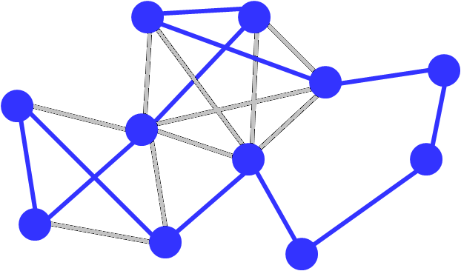
Traveling Salesman

Slide 41
5-Clique

Slide 42
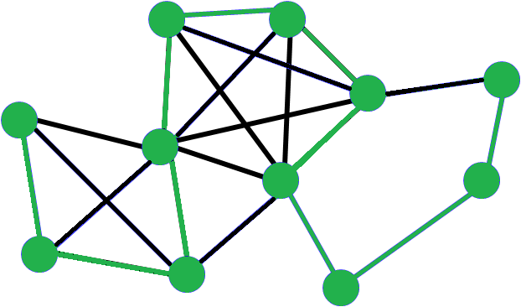
Hamiltonian Path

Slide 43
Map Coloring

Slide 44
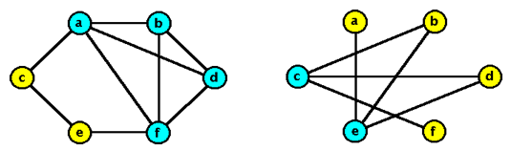
Vertex Cover (VC)
Given a graph and an integer k, is there a collection of k vertices such that each edge is connected to one of the vertices in the collection?

Slide 45
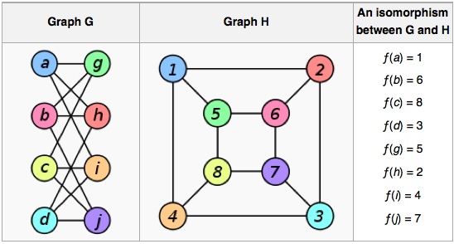
Graph isomorphism
Graph isomorphism is NP-hard; is it NP-complete?

Slide 46
Class Scheduling Problem
With N teachers with certain hour restrictions M classes to be scheduled, can we:
Schedule all the classes
Make sure that no two teachers teach the same class at the same time
No teacher is scheduled to teach two classes at once

Slide 47
Pair Programming Problem
With N students and K projects, where N is even, can we:
Assign pairs of students to each project
Every student works on every project
No student has the same partner more than once
Is this an NP-complete problem?

Slide 48
Satisfiability Problem
SAT
The circuit satisfiability problem (CIRCUIT-SAT) is the circuit analogue of SAT.
Given a Boolean circuit C, is there an assignment to the variables that causes the circuit to output 1?

Slide 49
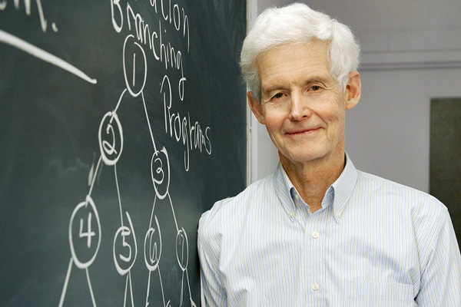
Cook’s Theorem
The Circuit Satisfiability Problem is NP-Complete

Slide 50
Circuit SAT
AND
Satisfying assignment
x₁ = T, x₂ = F, x₃ = F
x₄ = T, x₅ = T
OR
Find a satisfying assignment
OR
AND
AND
AND
AND
NOT
OR
NOT
OR
AND
NOT
OR
AND
AND
NOT
OR
NOT
AND
x₁
x₂
x₃
x₄
x₅

Slide 51
3-SAT
3-SAT and Boolean satisfiability problem are actually not complete synonyms.
3-SAT asks whether it is possible to solve the Boolean satisfiability problem provided that there are at most 3 variables between each pair of parentheses in the Boolean formula.
So, it's a simpler problem, but there is still no algorithm to solve that which is both always correct (not heuristic) and always runs in less than exponential time.

Slide 52
Proof of Cook’s Theorem
Reduce an arbitrary problem Y in NP to X
Let A be a non-deterministic polynomial time algorithm for Y
Convert A to a circuit, so that Y is a Yes instance if and only if the circuit is satisfiable

Slide 53
Populating the NP-Completeness Universe
NP-Complete
Circuit Sat <_{P} 3-SAT
3-SAT <_{P} Independent Set
3-SAT <_{P} Vertex Cover
Independent Set <_{P} Clique
3-SAT <_{P} Hamiltonian Circuit
Hamiltonian Circuit <_{P} Traveling Salesman
3-SAT <_{P} Integer Linear Programming
3-SAT <_{P} Graph Coloring
3-SAT <_{P} Subset Sum
Subset Sum <_{P} Scheduling with Release times and deadlines
NP
P

Slide 54
Satisfiability Problem (SAT)
Satisfiability problem: given a logical expression Φ, find an assignment of values (F, T) to variables x_{i} that causes Φ to evaluate to T
Φ = x₁ ∨ ¬ x₂ ∧ x₃ ∨ ¬ x₄
SAT was the first problem shown to be NP-complete!

Slide 55
CNF Satisfiability
CNF is a special case of SAT
Φ is in “Conjunctive Normal Form” (CNF)
“AND” of expressions (i.e., clauses)
Each clause contains only “OR”s of the variables and their complements
E.g.: Φ = (x₁ ∨ x₂) ∧ (x₁ ∨ ¬ x₂) ∧ (¬ x₁ ∨ ¬ x₂)
clauses

Slide 56
3-CNF Satisfiability
A subcase of CNF problem:
Contains three clauses
E.g.:
Φ = (x₁ ∨ ¬ x₁ ∨ ¬ x₂) ∧ (x₃ ∨ x₂ ∨ x₄) ∧ (¬ x₁ ∨ ¬ x₃ ∨ ¬ x₄)
3-CNF is NP-Complete
Interestingly enough, 2-CNF is in P!

Slide 57
Example of CNF Satisfiability
Φ = (x₁ ∨ ¬ x₂ ∨ ¬ x₃) ∧ (¬ x₁ ∨ x₂ ∨ ¬ x₃)
C₁
C₂
Exponential time Algorithms
0/1 knapsack – 2^{n}
TSP – 2^{n}
Sum of Subsets – 2^{n}
Graph coloring – 2^{n}
Hamiltonian cycle – 2^{n}
x₁ | x₂ | x₃
0 | 0 | 0
0 | 0 | 1
0 | 1 | 0
0 | 1 | 1
1 | 0 | 0
1 | 0 | 1
1 | 1 | 0
1 | 1 | 1
2³ = 8
possibilities

Slide 58
Example of CNF Satisfiability
Φ = (x₁ ∨ ¬ x₂ ∨ ¬ x₃) ∧ (¬ x₁ ∨ x₂ ∨ ¬ x₃)
Algorithms
0/1 knapsack – 2^{n}
TSP – 2^{n}
Sum of Subsets – 2^{n}
Graph coloring – 2^{n}
Hamiltonian cycle – 2^{n}
1
x₁
0
1
2
9
x₂
0
1
x₂
0
1
3
6
10
13
x₃
0
1
x₃
0
1
x₃
0
1
x₃
0
1
4
5
7
8
11
12
14
15
Space Tree

Slide 59
The Relationship
1
x₁
0
1
2
9
x₂
0
1
x₂
0
1
3
6
10
13
x₃
0
1
x₃
0
1
x₃
0
1
x₃
0
1
4
5
7
8
11
12
14
15
If this tree can solved in polynomial time, then
CNF, Knapsack, TSP, … can also be solved in polynomial time.

Slide 60
NP: Naming convention
NP-complete - problems that are 'complete' in NP, i.e. the most difficult to solve in NP
NP-hard - stands for 'at least' as hard as NP (but not necessarily in NP);
NP-easy - stands for 'at most' as hard as NP (but not necessarily in NP);
NP-equivalent - means equally difficult as NP, (but not necessarily in NP);

Slide 61
Reduction Example
3-CNF ≤_{p} Clique

Slide 62
5-Clique

Slide 63
Clique
Clique Problem:
Undirected graph G = (V, E)
Clique: a subset of vertices in V all connected to each other by edges in E (i.e., forming a complete graph)
Size of a clique: number of vertices it contains
Optimization problem:
Find a clique of maximum size
Decision problem:
Does G have a clique of size k?
Clique(G, 2) = YES
Clique(G, 3) = NO
Clique(G, 3) = YES
Clique(G, 4) = NO

Slide 64
Clique Verifier
Given: an undirected graph G = (V, E)
Problem: Does G have a clique of size k?
Certificate:
A set of k nodes
Verifier:
Verify that for all pairs of vertices in this set there exists an edge in E

Slide 65
3-CNF ≤_{p} Clique
Idea:
Construct a graph G such that Φ is satisfiable only if G has a clique of size k

Slide 66

3-CNF ≤_{p} Clique
SAT $∝$ Clique DP
C₁
C₂
C₃
k
F = (x₁ ∨ x₂) ∧ (¬x₁ ∨ ¬ x₂) ∧ (x₁ ∨ x₃) =
F = ∧ c_{i}
i=1
G = { <a, i> | a ∈ c_{i} }
E = { <a, i>, <b, j> | i ≠ j and b ≠ ¬a }
[¬ x₁ , 2]
[¬ x₂ , 2]
[x₁ , 1]
[x₁ , 3 ]
[x₂ , 1]
[x₃ , 3]

Slide 67
3-CNF ≤_{p} Clique
SAT $∝$ Clique DP
C₁
C₂
C₃
k
F = (x₁ ∨ x₂) ∧ (¬x₁ ∨ ¬ x₂) ∧ (x₁ ∨ x₃) =
F = ∧ c_{i}
i=1
G = { <a, i> | a ∈ c_{i} }
[¬ x₁ , 2]
[¬ x₂ , 2]
Do not connect vertices of the same close
Don not connect a node to its negation
[x₁ , 1]
[x₁ , 3 ]
[x₂ , 1]
[x₃ , 3]

Slide 68
3-CNF ≤_{p} Clique
SAT $∝$ Clique DP
C₁
C₂
C₃
k
F = (x₁ ∨ x₂) ∧ (¬x₁ ∨ ¬ x₂) ∧ (x₁ ∨ x₃) =
F = ∧ c_{i}
i=1
G = { <a, i> | a ∈ c_{i} }
[¬ x₁ , 2]
[¬ x₂ , 2]
[x₁ , 1]
[x₁ , 3 ]
[x₂ , 1]
[x₃ , 3]

Slide 69
3-CNF ≤_{p} Clique
SAT $∝$ Clique DP
C₁
C₂
C₃
k
F = (x₁ ∨ x₂) ∧ (¬x₁ ∨ ¬ x₂) ∧ (x₁ ∨ x₃) =
F = ∧ c_{i}
i=1
G = { <a, i> | a ∈ c_{i} }
k = 3
[¬ x₁ , 2]
[¬ x₂ , 2]
[x₁ , 1]
[x₁ , 3 ]
[x₂ , 1]
[x₃ , 3]

Slide 70
3-CNF ≤_{p} Clique
SAT $∝$ Clique DP
k = 3
[¬ x₁ , 2]
[¬ x₂ , 2]
x₁ = 0
[x₁ , 1]
[x₁ , 3 ]
[x₂ , 1]
[x₃ , 3]
x2 = 1
x3 = 1
F = (x₁ ∨ x₂) ∧ (¬x₁ ∨ ¬ x₂) ∧ (x₁ ∨ x₃)
C₁
C₂
C₃
0 ∨ 1
1 ∨ 1
0 ∨ 1
1
1
1
= 1

